Slide 1
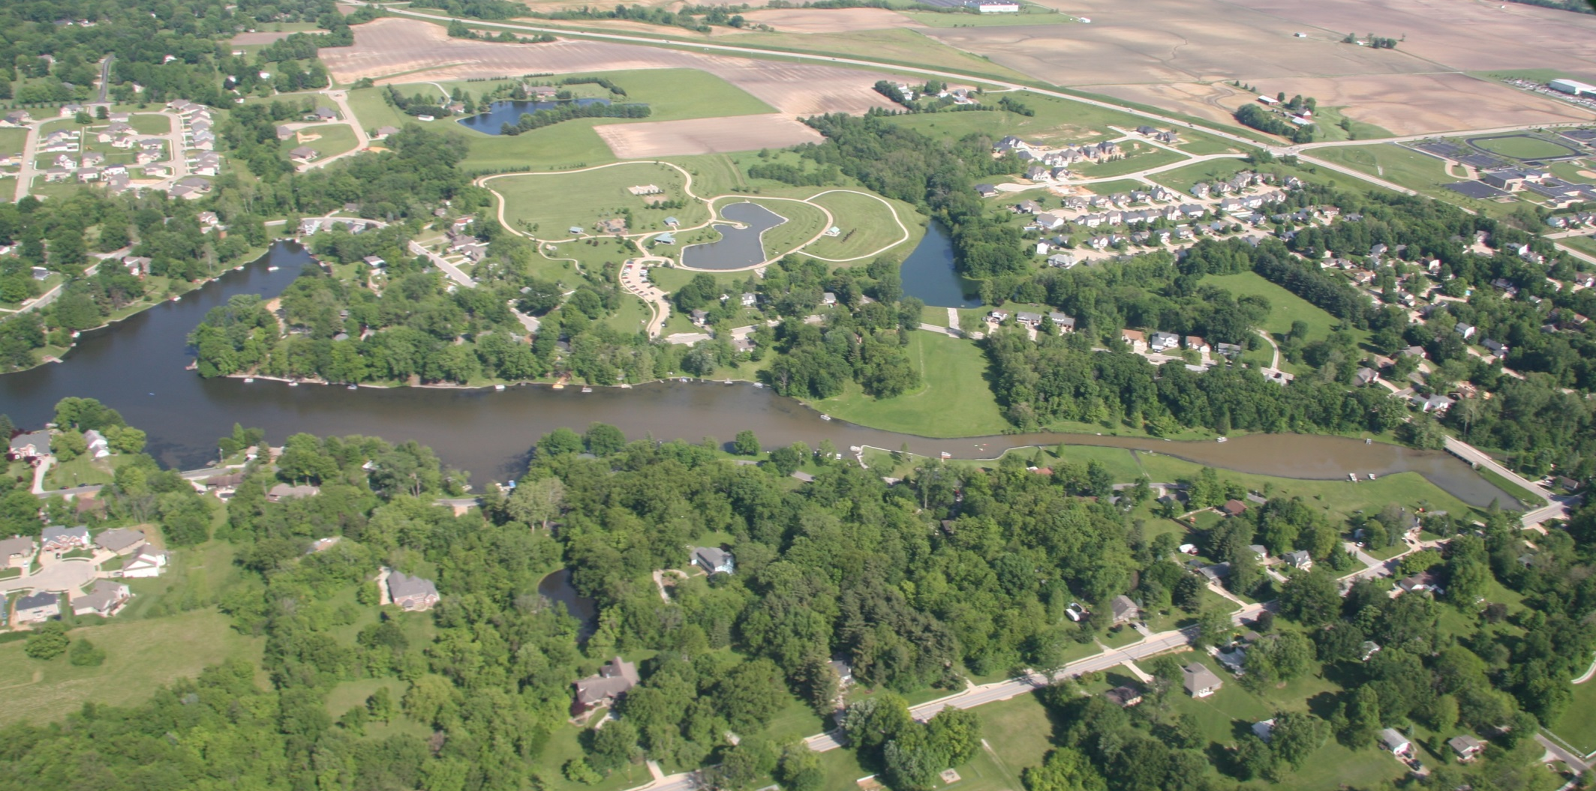
Silt entering Dunlap Lake on Sunday, May 15, 2016, from Friday’s rain

Slide 2
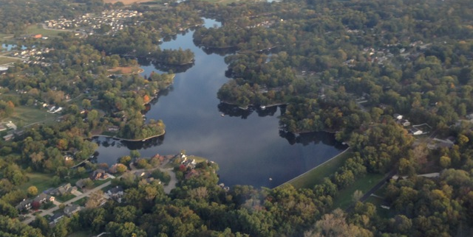
DREDGING PROPOSAL + SILT MANAGEMENT PLAN
Lake & Infrastructure Improvement Projects
Alan Ortbals, DLPOA President

Slide 3
AGENDA:
Welcome, Introductions & Announcements
Existing Conditions, Why it is a Concern
Dredging & Silt Management Plan
Timeline and Budget
Funding Alternatives
Next Steps
Q & A

Slide 4
Background
Since lake was dredged in 1991
2005 Cochran Wilkins designed a Silt Basin but it was not implemented,
2007 Dredging plan – voted down by membership
2008 Hurricane Ike – City rebuilt road and created a mini version of Cochran Wilkins silt basin that is already full
2012 Current Dredging Plan initiated with Horner & Schifrin

Slide 5
Siltation Continues
2005 – 130,000 cubic yards
needed to be removed
2016 - 150,000 cubic yards of silt need to be removed

Slide 6
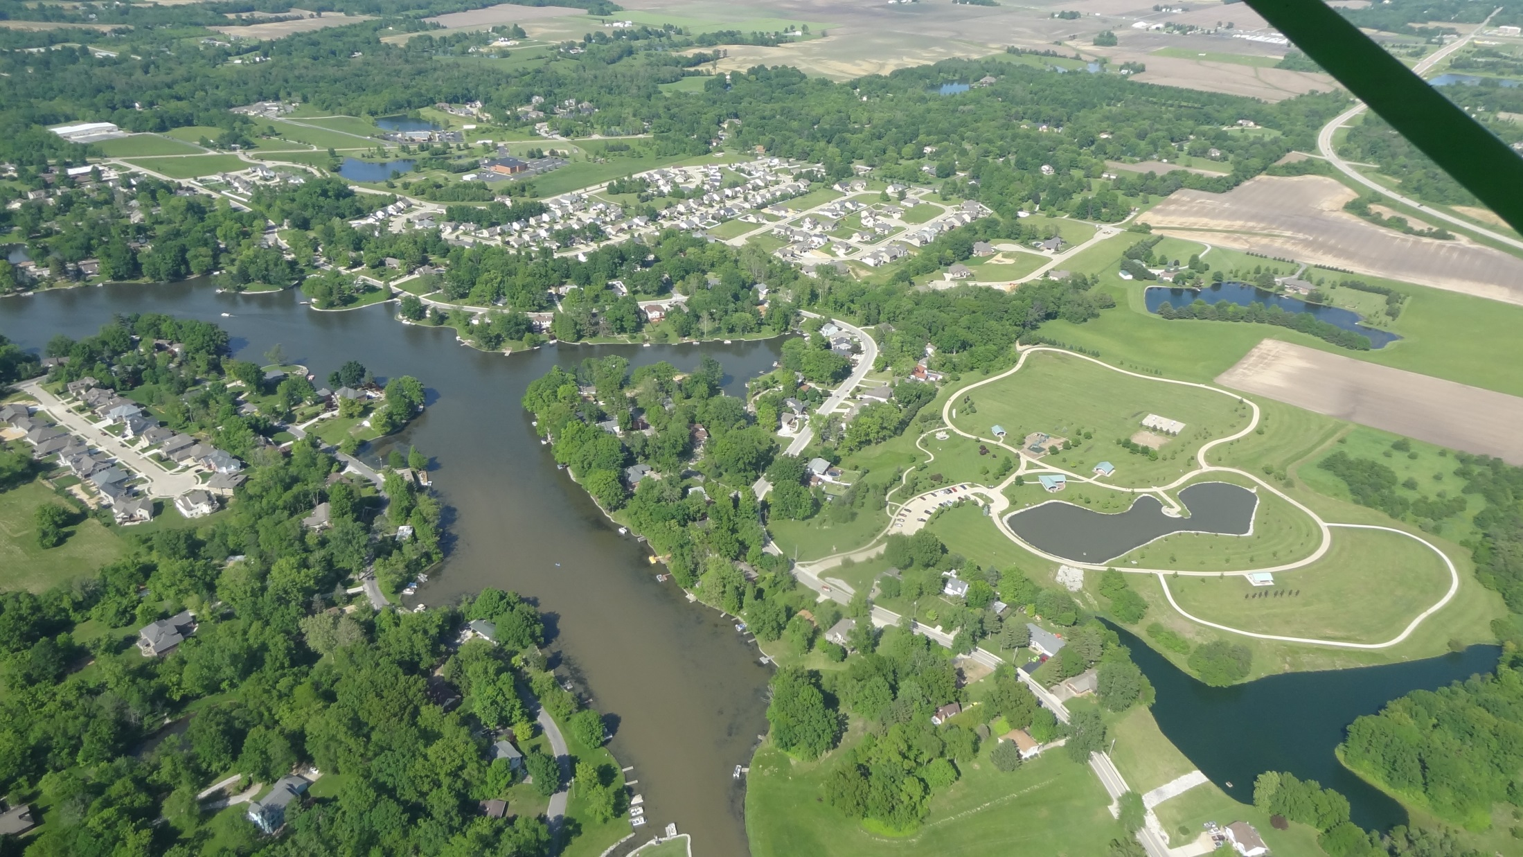
Why it Matters
Greg Brumitt, New Board Member

Slide 7
Long Term Impact of Silt
Lakes have a natural lifespan. Eutrophic or dying lakes are typically:
Declining
High in phosphorus and nitrates
Shallow with thick murky bottoms
Filled with aquatic plants

Slide 8
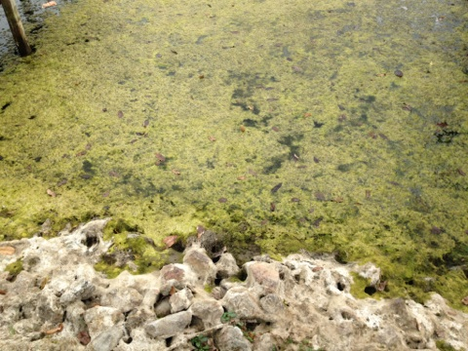
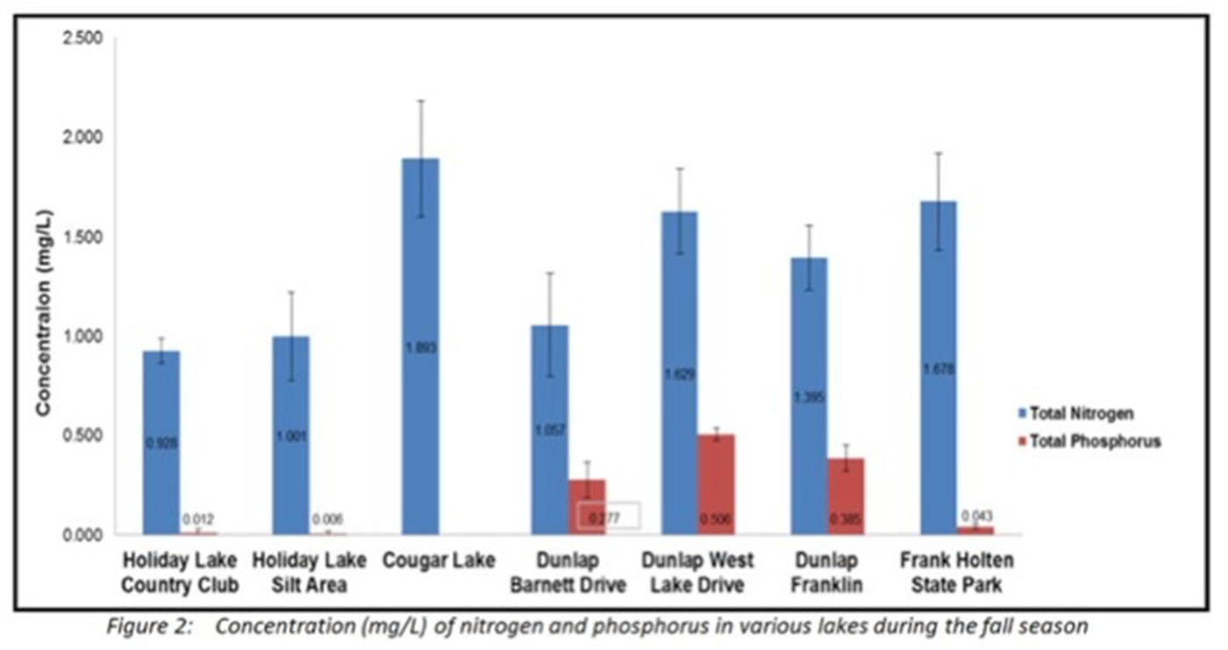
Phosphorus in Dunlap Lake is . . .
HIGHER THAN
Holiday Shores
Cougar Lake
& Frank Holten
State Park Lake
PUT TOGETHER

Slide 9
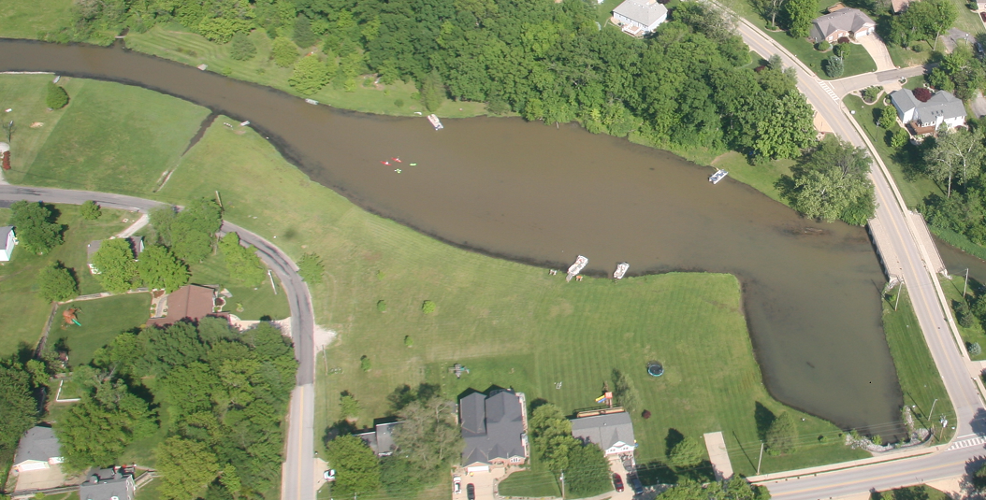
Lake Siltation Progression over Time
Design Graphics by Andy Leek – Building Chair

Slide 10
Why it Matters
Research shows a good view of a lake or ocean can increase home values as much as 300%
Declining water quality can decrease home values
As the lake fills in, average water temperature will rise creating opportunities for more algae blooms and a loss of oxygen levels that can cause fish kills and related conditions.

Slide 11
Lake proximity increases value
Studies from around the country show living close to or on a lake increase’s home values. For example:
Dunlap Lake homes demonstrate an unusual appeal for area
Strong market for teardowns, infill and major rehabs
Minnesota – a study of 22 lakes showed water clarity and quality was the single biggest variable in property value.
Denver - Grant Ranch subdivision homes with views of lake sold for $50-$100k more on average than comparable home nearby.

Slide 12
Approach
For 4 years we have worked with a professional engineering firm for to review:
Possible sites
Ways to save costs
The most efficient plan possible

Slide 13
Dredging Plan
Craig Louer, Silt Committee Chair

Slide 14
Dredging & Silt Management Plan
Phase I – Dewatering Facility
Phase II – South End Silt Retention Pond
Phase III – Remove silt with dredge barge
Budget $4.5 million
Affordable Financing

Slide 15
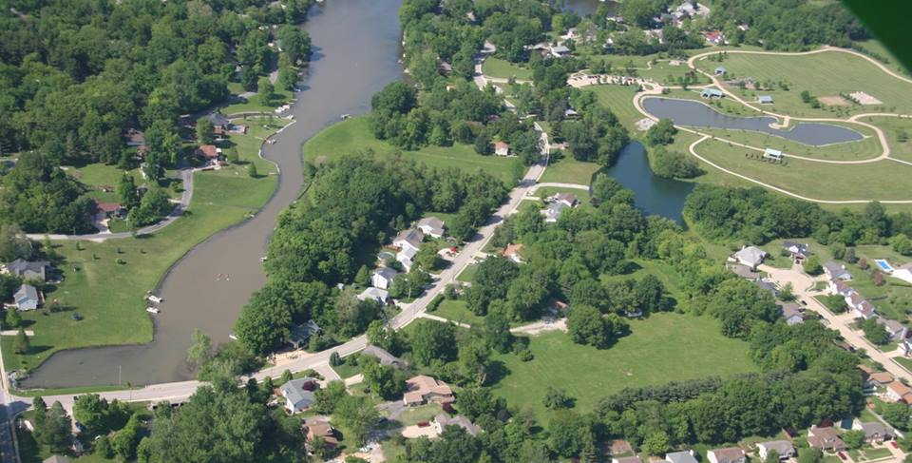
Dredging and Siltation Plan Demo
Design Graphics by Andy Leek – Building Chair

Slide 16
Phase I - Dewatering Facility

Slide 17
Phase II. Silt Retention Basin

Slide 18
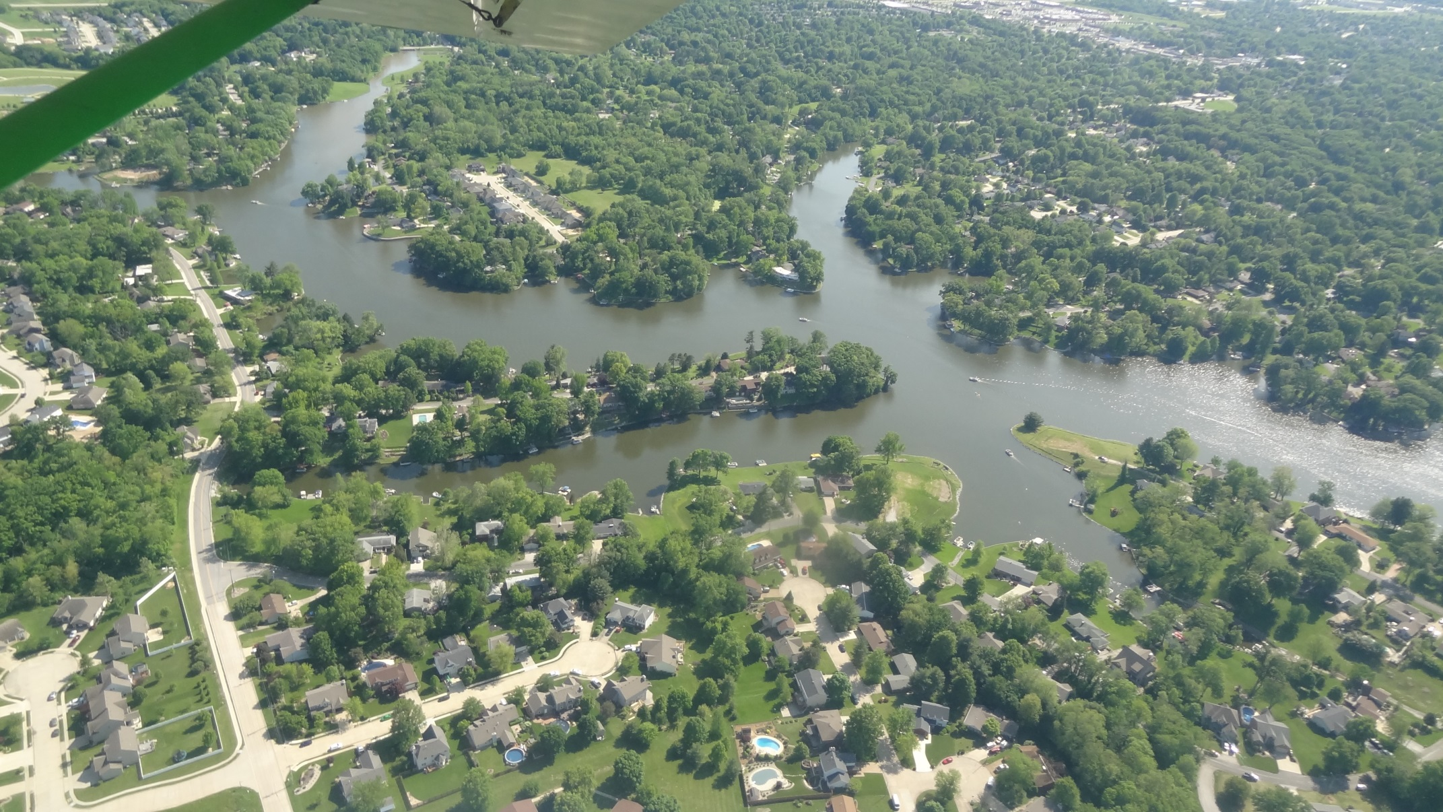
Phase III Dredging

Slide 19
Timeline
Fall 2016 – Apply for permits and complete financing. Begin work on dewatering facility at 840 East Lake.
Early 2017 – Take out house and excavate 46,000 cu/yds of dirt from dewatering facility berms. Any remaining dirt will go on E8
Fall 2017 – Build silt retention basin at the south end
March & Nov. 2018-2022 – Dredge for 6 weeks each spring and summer until all the designated coves have been cleared

Slide 20
Budget
The total project will cost $4.5 million which can be financed over a 20-year period with easy annual payments.
Planning, Permitting- $137,500
Refinance Property – 320,00
Phase I – Dewatering facility $637,892
Phase II – Silt retention basin $871,717
Dredging – $2,592,420
Contingency - $57,000

Slide 21
Long Term Maintenance
Operating expenses – will be used to clean out trash captured at the south end as needed
A reserve fund will be established from the general fund to clean out the silt retention basin

Slide 22
Financing
Alan Ortbals, DLPOA President

Slide 23
Financing Alternatives
Special assessment: one, lump sum payment, financing on your own
Bank loan backed by multi-year special assessment – not available
Special Service Area (SSA)

Slide 24
How a SSA works
Special Service Areas are established by a city council pursuant to state law to provide specific services to a specific area:
Services are paid for by an additional property tax
SSA property tax is based on assessed value
Allows for the sale of bonds to finance designated project
Tax rate is determined by the county based on tax base and debt service
SSA tax is on your property tax bill each year until the bonds are retired. Due and payable the same as the rest of your tax bill

Slide 25
Advantages of SSA
Debt is usually financed over 20 year period, reducing annual outlay for taxpayers
Generally carry a lower interest rate because the debt is secured by property taxes
SSA taxes are deductible on your federal tax return if the project is to maintain infrastructure

Slide 26
Estimated SSA Tax
Properties in the SSA = 358
Total assessed value of the SSA = $24 million
Project cost (bond proceeds) = $4.5 million
Term = 20 years
Interest rate = 4%
Annual debt service = $328,500
Projected tax rate to service debt = .014
Average (mean) assessed value = $67,000
Average annual SSA tax = $938
Increase in your property tax = 20%

Slide 27
Individual Alternatives
Property owners may be able to buy out of the SSA buy making full cash payment up-front
Must maintain contiguity of the SSA
Buy out amount would be based on assessed value of your property
Moran Economic Development will manage the SSA and buy out process 618-307-9100, keith@morandevelopment.com

Slide 28
Next Steps?
Members vote on the Special Service Area (SSA)
Request the City establish SSA
City Council must vote to establish SSA
Final engineering and permitting
If everything is approved construction on dewatering facility could begin in the summer of 2017

Slide 29
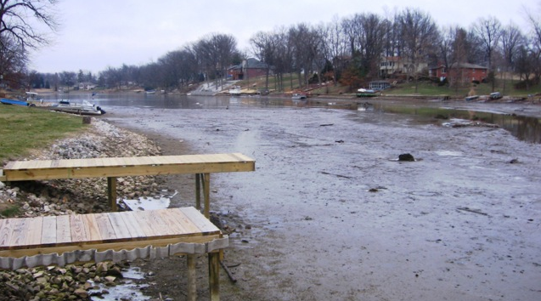
20,369 cubic yards of silt deposited since the 2015 vote

Slide 30
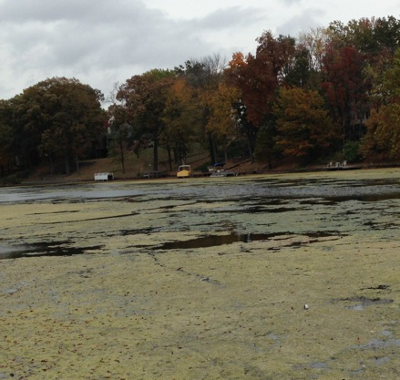
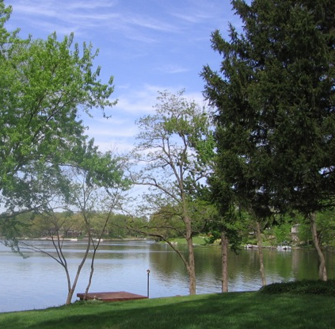
Do we have your support?

